Slide 1
THE GUIDE
Ugly truths & success factors of sustainable procurement
Get inspired and contribute your real-life insights into your sustainable procurement journey

Slide 2


THE GUIDE – get involved
Why
What
Who
We Need Speed!
Improving the sustainability of procurement practices is not easy! However, both the business and societal benefits are huge. We need to gain momentum by learning from each other. THE GUIDE offers open-source practical learning to all.
Easy, Practical Guidance
THE GUIDE shines a light on the real challenges (‘Ugly Truths’) we all face and responds to them with tried and tested success factors supported by real world case studies.
Everyone!
What the world needs now is…
Courageous Collaboration. Each and everyone of us need to bring questions and answers together. THE GUIDE offers a platform for shared learning and celebrates those willing to help lead the way. YOUR input, whether feedback or a case-study is what our community needs.
Thank you for YOUR support!

Slide 3



Support Community Learning
Get Active in 3 Steps
#1
Take a look at
THE GUIDE
#2
Provide feedback
#3
Submit a
case-study
Visit our website to view and download THE GUIDE. Share it with colleagues and friends.
Let us know what parts were useful and what you feel could add additional help. Use this feedback form.
Take an active role in helping the SPP community and submit a case study using the template on the next slide, and submit to info@spp.earth

Slide 4
WRITING GUIDELINES
Implementers only: only case studies written from the perspective of the implementing company are accepted (no solution provider).
Use 3rd person. For example, [Company name] has implemented the following approach…
Use clear accessible language by breaking down information, explaining acronyms, and defining technical terms so diverse audiences can understand.
Use objective, non-competitive language that avoids commercial and selling interest.
For example, after introducing the names, use “the solution provider” or “the adopting company” instead of company names, “the technology” instead of product names, and avoid words such as “groundbreaking”, “innovative”, etc.
Use concise language by avoiding repetition and keeping answers to one key idea. Please stay in the maximum character range for each question.
The text will be formatted in font Calibri Light (body), font size 10
For any questions, please contact: info@spp.earth

Slide 5
Title (Max 45 Characters)
Placeholder company logo or group / chapter name
Which SPP thematic track does your case study align with? select: People, Planet, or Profession
What approach did you take to tackle the challenge? max 900 characters. Outline your approach, including key actions and implementation steps.
What was the outcome, and how did you measure the impact? max 900 characters. Include intended or actual business & sustainability results - positive or negative - and how they were measured.
Where does your case study sit within the procurement lifecycle? max 100 characters. See Sustainable Procurement Wheel for reference.
Placeholder for at least one (ideally two) impact KPIs with short description
max 50 characters
What was the core challenge you were facing, and what was the context? max 800 characters. Describe the problem statement and include relevant company profile, location, or cultural aspects that shaped the challenge.
Placeholder author photo
High resolution photos only
Who was involved and how did you build buy-in (or not)? max 700 characters. Include key internal and external stakeholders / suppliers and explain how you justified the approach internally.
Author(s) Name(s)
Author(s) title(s)

Slide 6
Title (Max 45 Characters)
What was the cost or investment required, and what have been the expected (or unexpected) business trade-offs or benefits? max 700 characters. Share budget or resource needs, might be qualitative, and share the business impact —good or bad—along the way.
What was the “ugly truth” you encountered & what would you do differently next time? max 800 characters. Provide insight into what was hard or frustrating, offering practical advice, risks, or tips for others looking to replicate your approach.
For whom would you recommend this initiative? max 700 characters. Suggest business profiles (e.g., considering sector, geographies, sustainability maturity) and / or specific business functions
What were the key success factors? max 800 characters. Reflect on what enabled success.
How would you recommend those with fewer resources approach this? max 700 characters. Suggest ways to adapt or simplify the approach for teams with limited capacity.

Slide 7
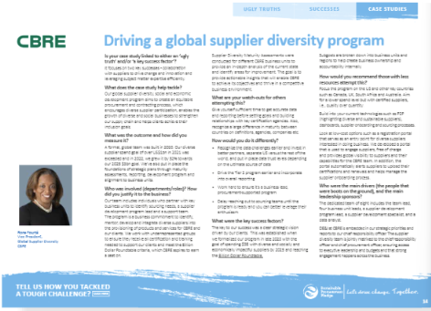
Peer Review Process
If you would like to have your case study included on our official webpage for The Guide, please submit it for peer review.
A group of procurement professionals will review and give feedback where necessary on your case study and a final decision will then be made on its inclusion.
Case studies that go through the official peer review process will be transferred to the blue background and prepared for publication.
Please submit your case study to info@spp.earth

